Slide 1

Car Price Prediction
Identifying Factors Influencing Car Price
Notes:
PARISHA

Slide 2

Setting Up The Analysis
What are the most significant factors that influence car prices?
How do technical specifications like engine size, horsepower, and fuel type affect car prices?
Are there certain car brands that are priced higher, even when accounting for technical specifications?
How does fuel efficiency (city and highway MPG) impact the price of a car?
Is there a significant difference in price between different car body types (e.g., sedan, hatchback, convertible)?
Notes:
PARISHA

Slide 3

Datasets, Data Loading and Preprocessing
Dataset:
Car Price Assignment dataset (CarPrice_Assignment.csv), sourced from Kaggle
Data Loading and Preprocessing:
Loaded data using Spark to handle large-scale data processing.
Data was converted to a Pandas DataFrame for further analysis
Certain features, such as engine size, horsepower, and other technical specifications, were hand selected
Missing values and data inconsistencies, if any, were filtered out during preprocessing
Exploratory Data Analysis
Generated correlation matrix to identify relationships between variables
Generated various charts to visualize the importance of car features in predicting car prices. Features included engine size, horsepower, fuel efficiency, and car brand
Notes:
FINN

Slide 4
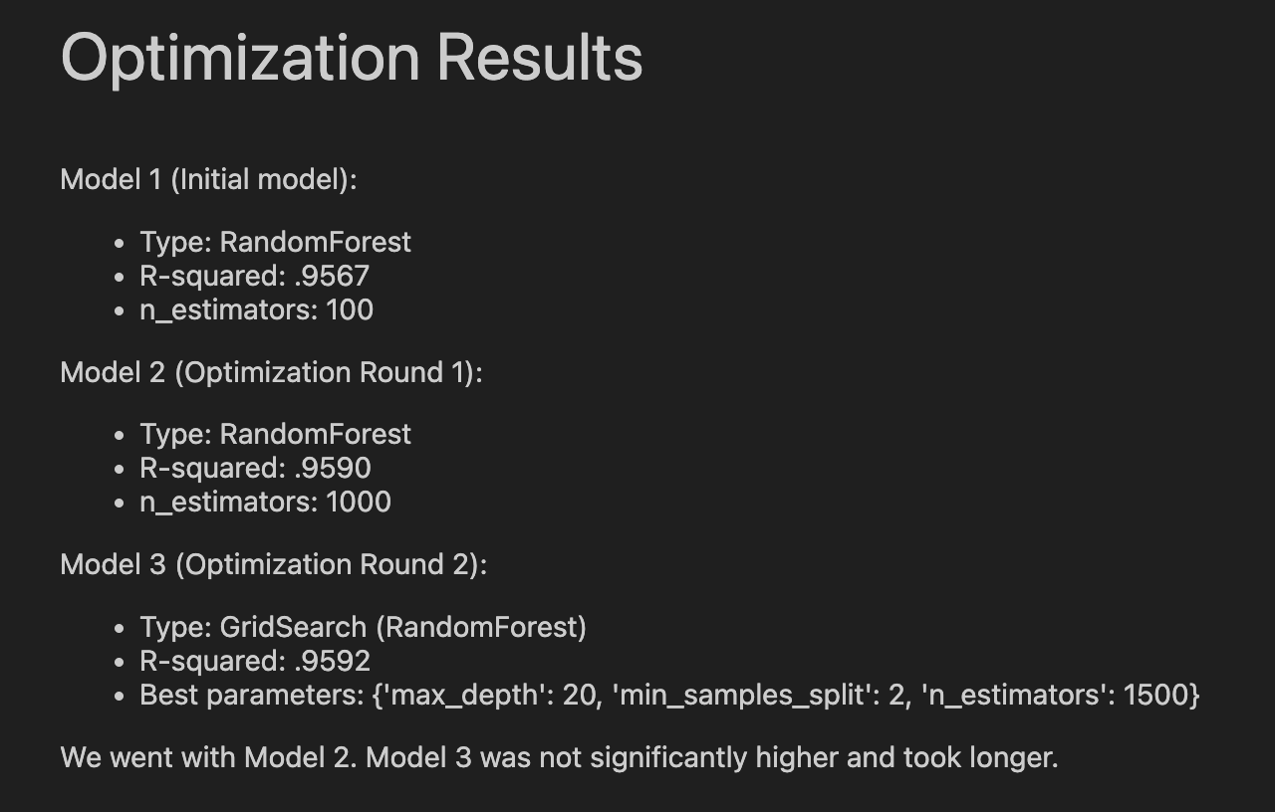
Data Modeling, Evaluation, and Optimization
Modeling:
The dataset was split into training and testing sets using train_test_split
Features were scaled using StandardScaler to standardize the range of values
A Random Forest Regressor model was built to predict car price
GridSearchCV was used for hyperparameter tuning to optimize the model
Evaluation and Optimization:
The model's performance was evaluated using the R² Score to understand how well the model explained the variance in car prices
The n_estimators factor (n_estimators=1000) in the RandomForestRegressor had the biggest impact on quality of performance by the model
Notes:
FINN

Slide 5
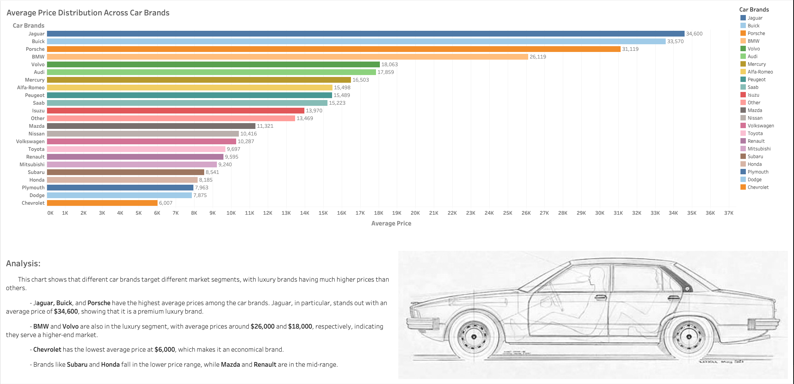
Notes:
SANEM

Slide 6
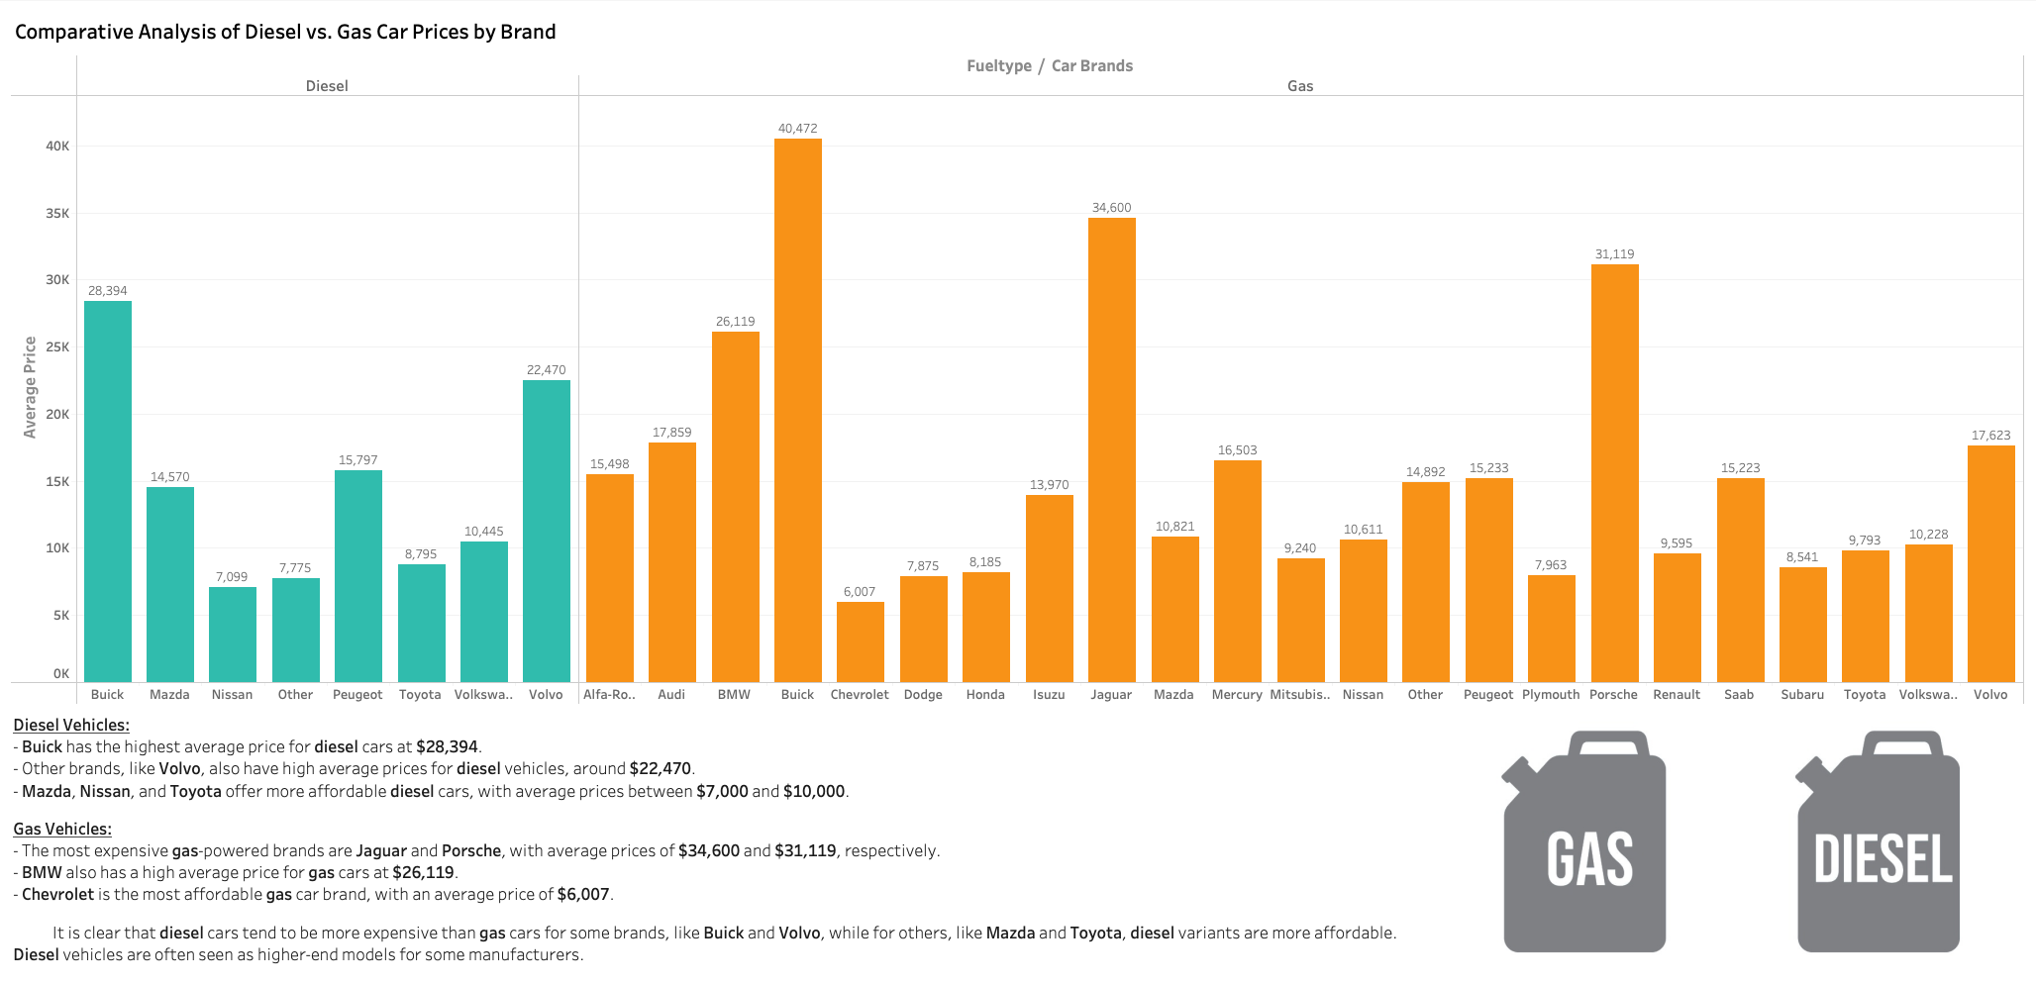
Notes:
SANEM

Slide 7
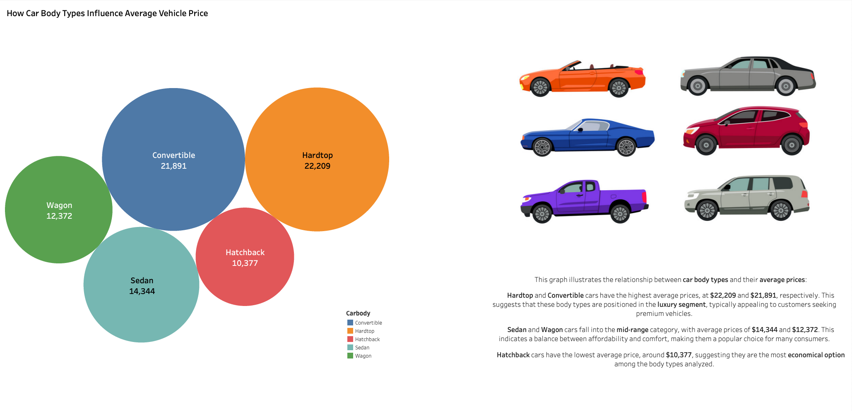
Notes:
SANEM

Slide 8
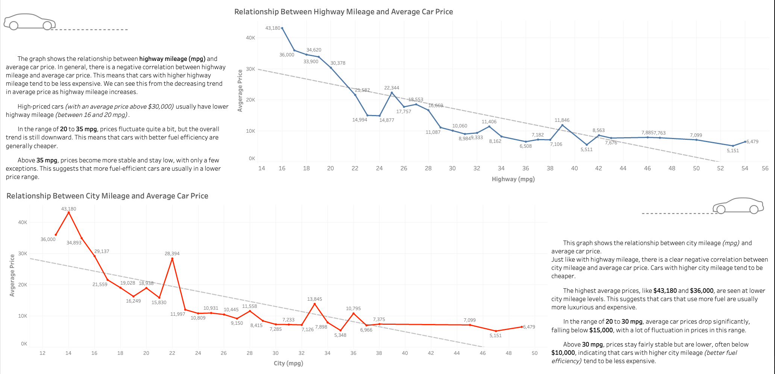
Notes:
SANEM

Slide 9
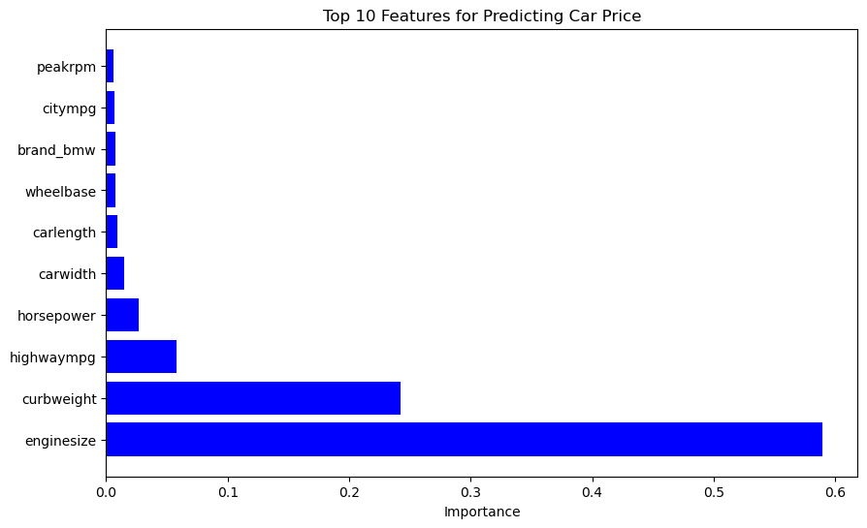
What are the most significant features that influence car prices?
This bar chart highlights the top 10 most influential features in predicting car prices according to their importance values.
The largest contributing features are engine size and curb weight, with engine size having the highest influence on car price.
This visualization helps us understand which features to focus on when optimizing car price prediction models or refining feature selection for price prediction.
Notes:
JOHN

Slide 10
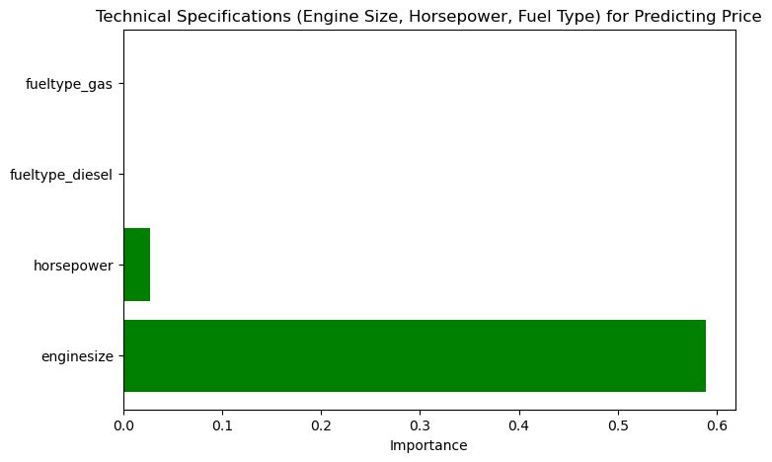
How do technical specifications like engine size, horsepower, and fuel type affect car prices?
This chart breaks down how specific technical specifications—engine size, horsepower, and fuel types (gas or diesel)—influence the prediction of car prices.
Like the first chart, engine size dominates the impact, followed by horsepower. The low influence of fuel types suggests that it is not a significant factor in determining its price. This might indicate that the price is more affected by the car's performance and specifications than its fuel type.
Notes:
JOHN

Slide 11
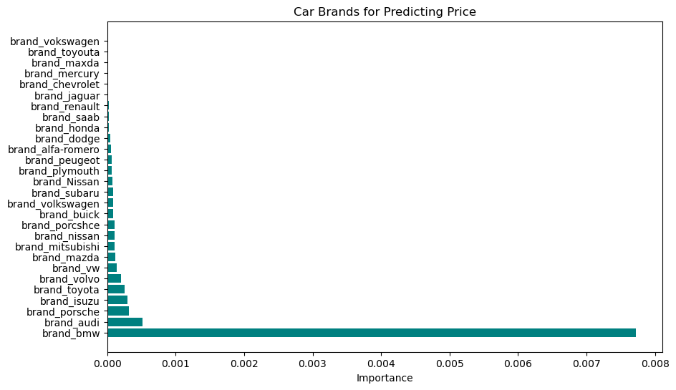
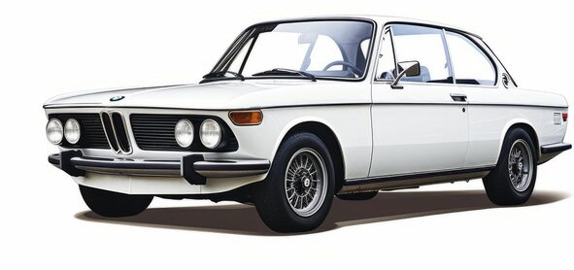
Are certain car brands priced higher, even when accounting for technical specifications?
Notes:
JACKSON

Slide 12
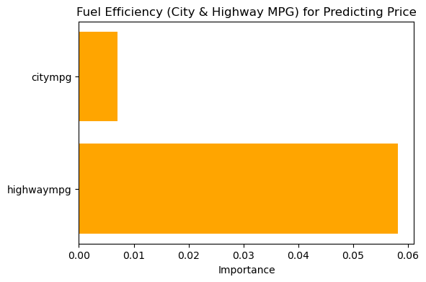

How does fuel efficiency (city and highway MPG) impact the price of a car?
Notes:
JACKSON

Slide 13
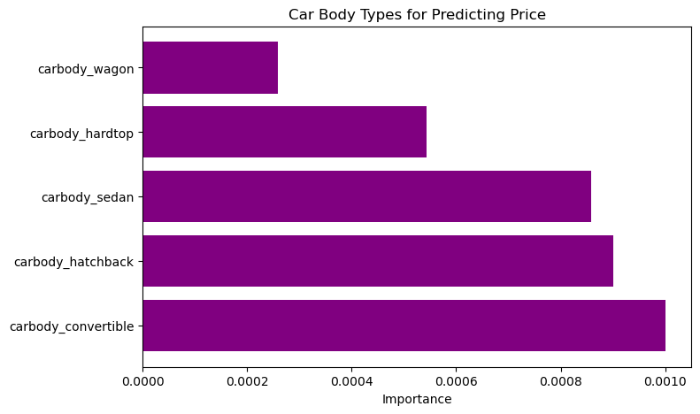
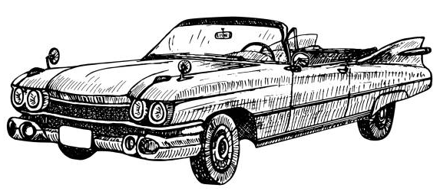
Is there a significant difference in price between different car body types (e.g., sedan, hatchback, convertible)?
Notes:
JACKSON

Slide 14
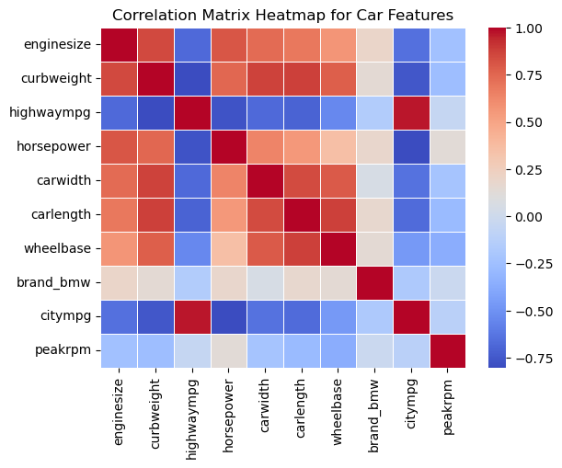
Correlation Matrix
The purpose of the correlation matrix is to identify relationships between the top 10 most influential features influencing car prices
1. Size and Power: Larger cars, like those with higher curbweight, carwidth, and enginesize, are strongly correlated with having more powerful engines, as seen in their positive relationship with horsepower.
2. Fuel Efficiency: Fuel efficiency measures like citympg and highwaympg are inversely related to car size, indicating that bigger cars tend to be less efficient in terms of fuel consumption.
3. Brand Influence: Brand_bmw shows a slight positive correlation with size-related features, suggesting that BMW cars in this dataset tend to be larger and more powerful compared to others.
4. Peak RPM and Power: Peakrpm generally decreases with larger cars but is positively correlated with horsepower, implying that more powerful engines may operate at higher RPMs despite overall vehicle size.

Slide 15

Takeaways
Based on the feature importance from the second Random Forest model (model_2), the most significant factors influencing car prices were Engine Size, Curb Weight, Highway MPG and Horsepower.
Certain car brands, particularly luxury brands like BMW and Audi, showed greater influence on predicting car prices even after accounting for technical specifications.
Fuel Efficiency shows highway mpg and city mpg both making the top ten influential features in determining car price, but highway mpg is clearly more influential than city as it has over 10x more importance.
In terms of Body Type, convertibles and hatchbacks tended to have greater influence on price compared to sedans, hardtops and wagons, likely due to their design, functionality, and market positioning.
Notes:
PARISHA

